Slide 1
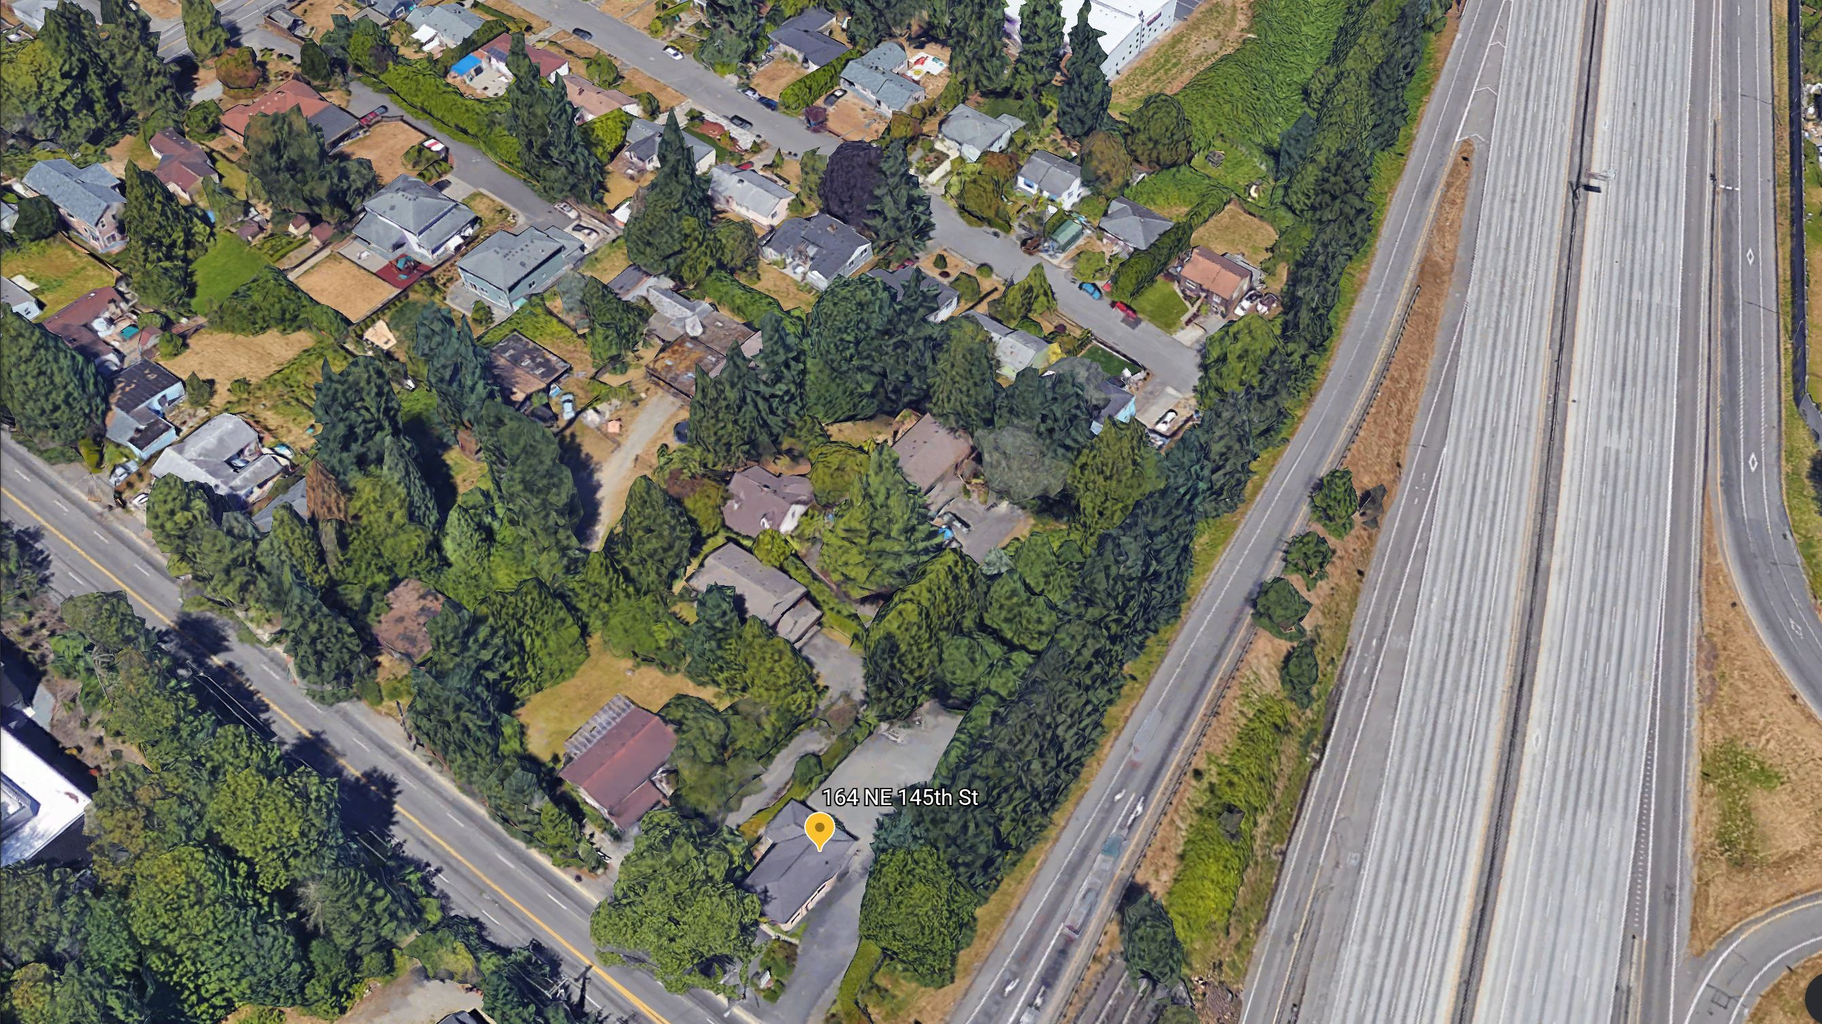

shoreline mu70

Slide 2

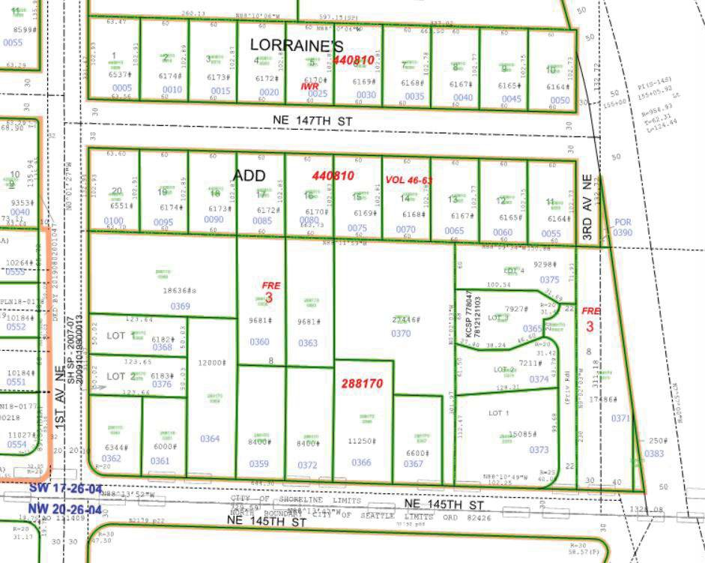

OFFERING MEMORANDUM
145th STREET LIGHT RAIL SHORELINEMUR-70 DEVELOPMENT SITE
unique opportunity!
7 lots
60,422 total lot sq. ft.
388 units
PROJECT SITE
Exclusively offered by:
WINDERMERE REAL ESTATE/GH LLC
Windermere Real Estate/GH LLC
210 5th Ave S Suite 102 | Edmonds, WA 98020
edmonds@windermere.com | 425.672.1118

Slide 3
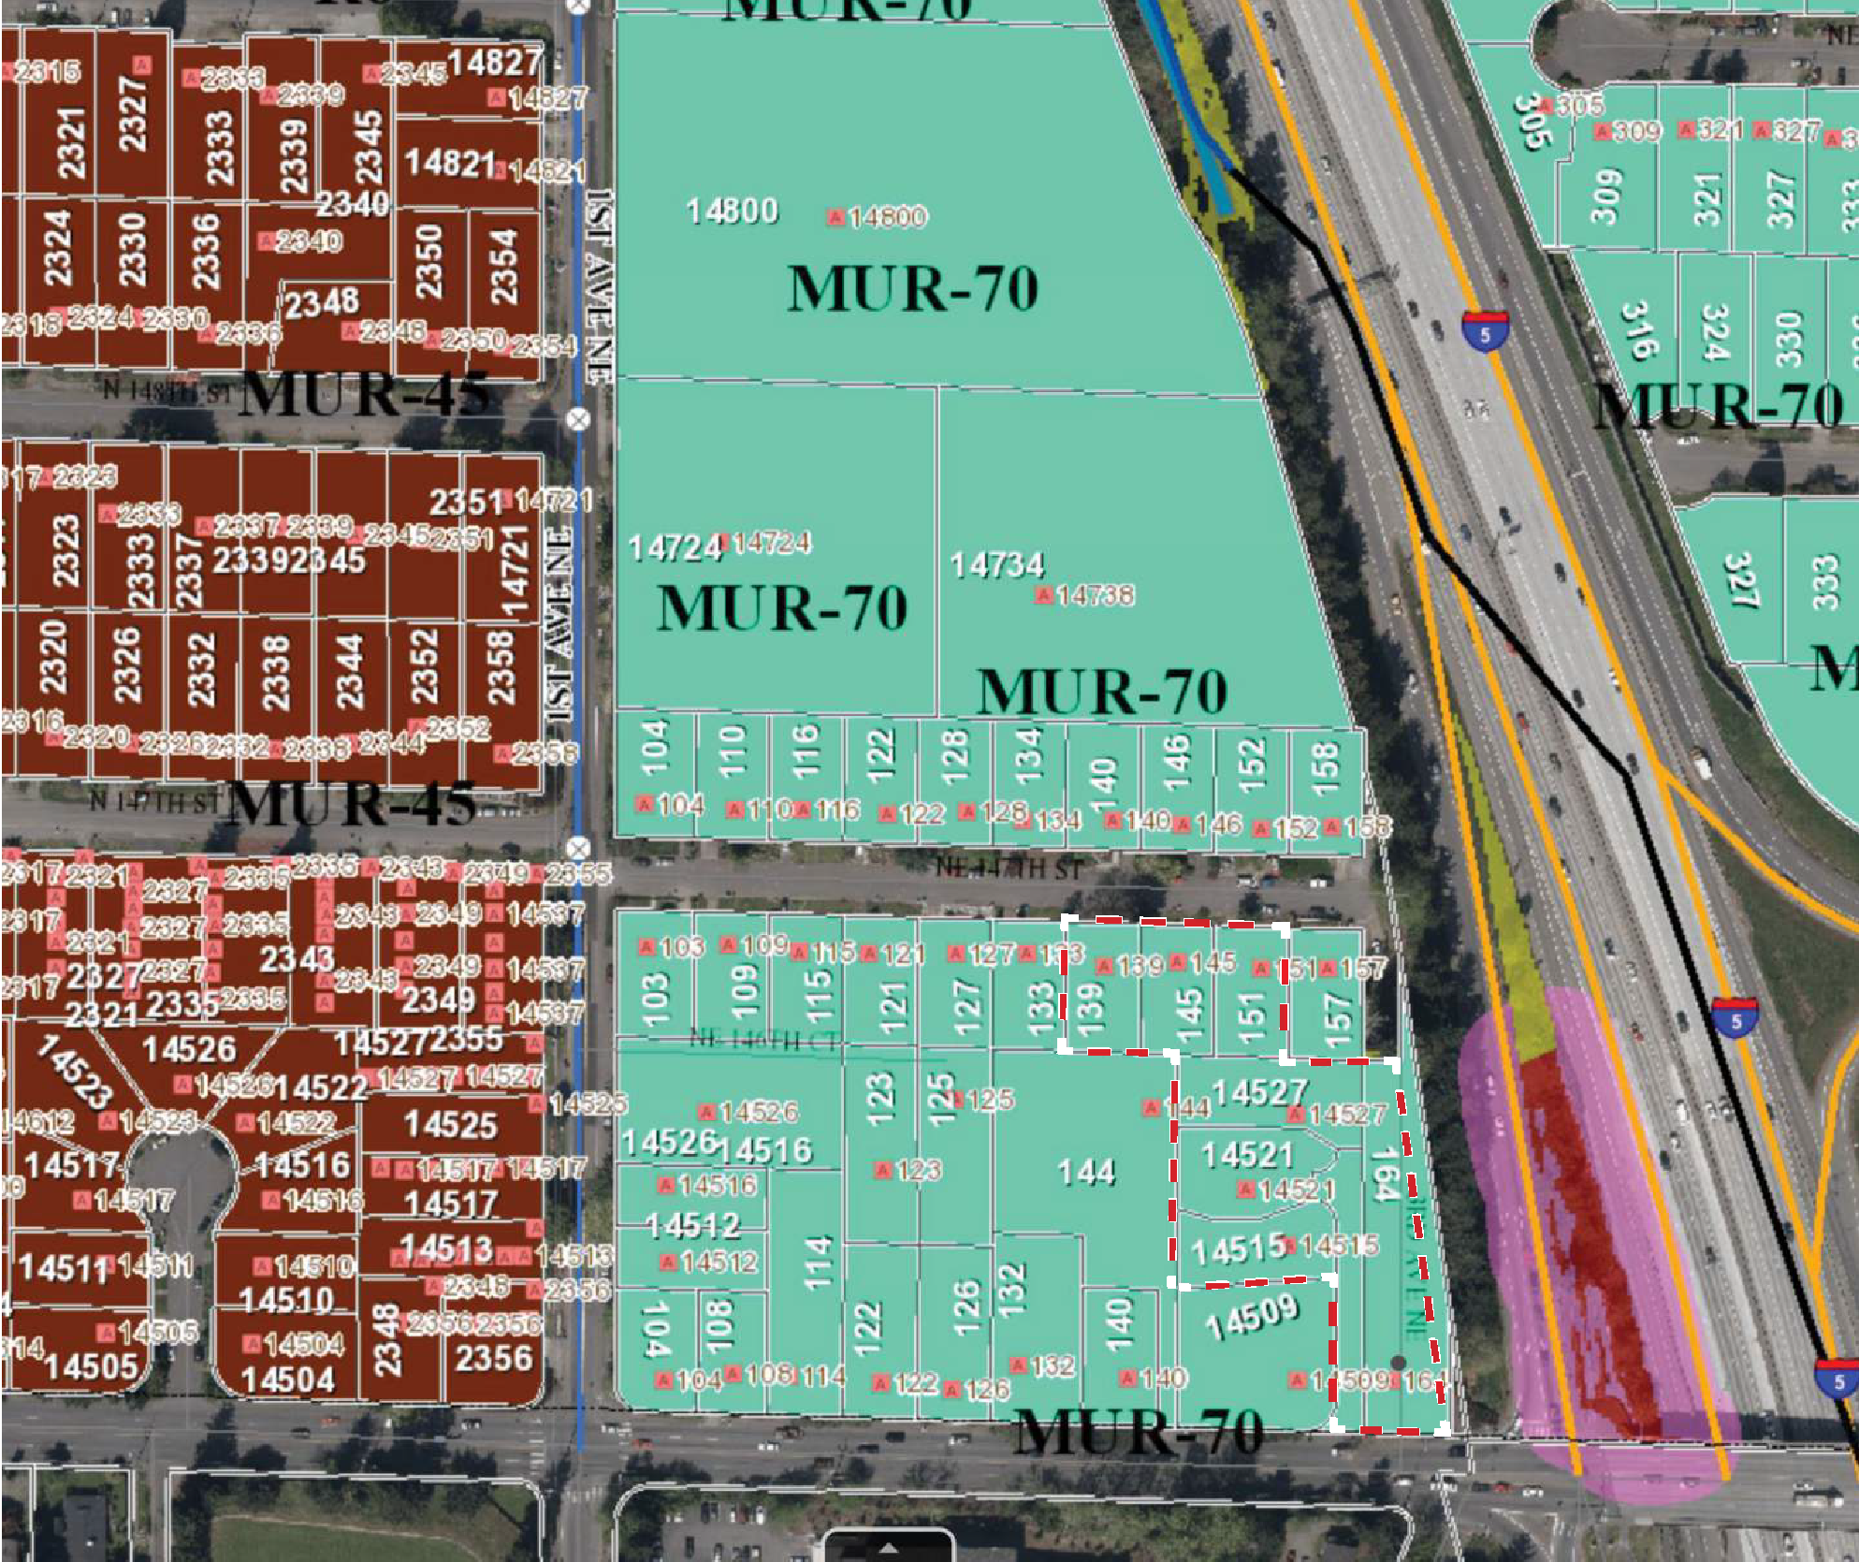
ZONING DATA
ADDRESSES
139, 145, 151 NE 147TH ST, 98155
14527, 14521, 14515 3RD AVE NE, 98155
164 NE 145TH ST, 98155
PARCEL #
440810-0070, 440810-0065, 440810-0060
288170-0375, 288170-0365, 288170-0374
288170-0371
ZONING
MUR-70
MAXIMUM BUILDING COVERAGE, HARDSCAPE
N/A , 90% max
SETBACKS
NE 147th St: 5 ft NE 145th St: 22 ft Sides: 5 ft
HEIGHT LIMIT
70 ft, measured from Average Existing Grade per SMC 20.50.050. 140 ft may be increased up to 140 feet through an approved Development Agreement application, but this study depicted the 70 ft option as it is more likely financially feasible and in keeping with current neighboring development.
DESIGN REVIEW
No design review if meeting design standards in the Municipal Code.
Optional administrative design review is required for deviations from the code.
PARKING
0.75 per Studio or 1-BR unit, 1.5 per 2-BR unit
Parking reduction: 25% because within 1/4 mile of Light Rail Station
SITE
RIGHT OF WAY DEDICATION
24.5’ for proposed WSDOT roundabout interchange
NON-MOTORIZED CONNECTION
One per block required
ASSUMPTION:
Fire truck access is allowed from NE 145th St
Area zoning map
Windermere Real Estate/GH LLC
210 5th Ave S Suite 102 | Edmonds, WA 98020
edmonds@windermere.com | 425.672.1118

Slide 4
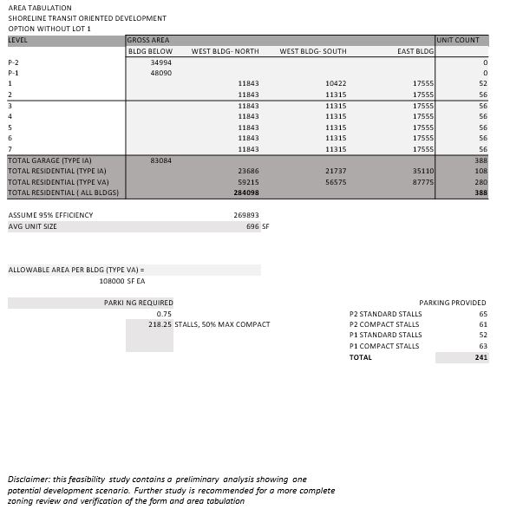
AREA TABULATION
Windermere Real Estate/GH LLC
210 5th Ave S Suite 102 | Edmonds, WA 98020
edmonds@windermere.com | 425.672.1118

Slide 5
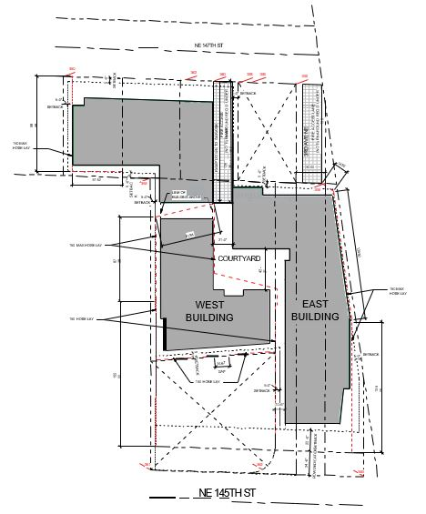
PROPERTY HIGHLIGHTS
Site located immediately across I-5 freeway and easily accessible by a pedestrian bridge the City of Shoreline plans to build across from 148th St.
__________________________________________________________
Northgate light rail station located 3 miles to the south. Opens in 2021.
__________________________________________________________
16 minutes to downtown Seattle from 145th light rail station
__________________________________________________________
Bus Stop on 145th St connecting to Lake City, Richmond Beach, Mountlake Terrace, and multiple other small suburbs
__________________________________________________________
High Daily traffic counts along 145th St and the I-5 corridor
__________________________________________________________
Costco, QFC, Starbucks, and all that Lake City way’s ‘Main Street’ has to offer is nearby
__________________________________________________________
Close proximity to Lakeside High School and multiple parks nearby
__________________________________________________________
Near Jackson Park Golf Course and Park
__________________________________________________________
University of Washington, Seattle Pacific University, and Seattle University all within 10 miles
Windermere Real Estate/GH LLC
210 5th Ave S Suite 102 | Edmonds, WA 98020
edmonds@windermere.com | 425.672.1118

Slide 6
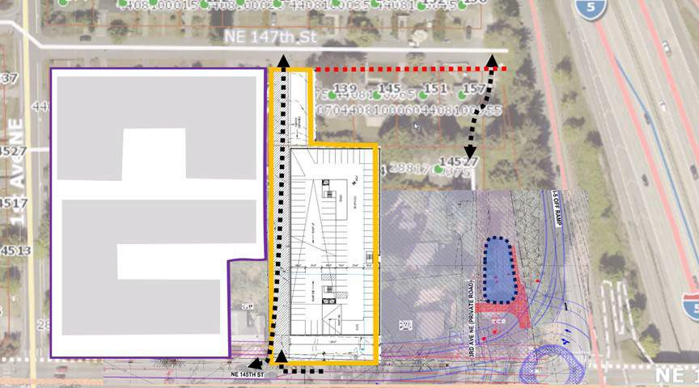
ADJACENT PROJECTS & POSSIBLE PUBLIC WORKS PROJECTS
Proposed through-block pedestrian connection on neighboring development site
Proposed roundabout at 145th
Potential detention pond on project site (TBD)
Windermere Real Estate/GH LLC
210 5th Ave S Suite 102 | Edmonds, WA 98020
edmonds@windermere.com | 425.672.1118

Slide 7
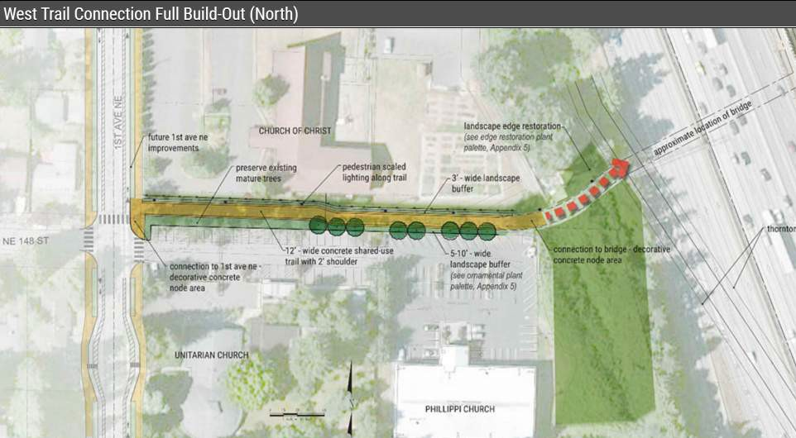
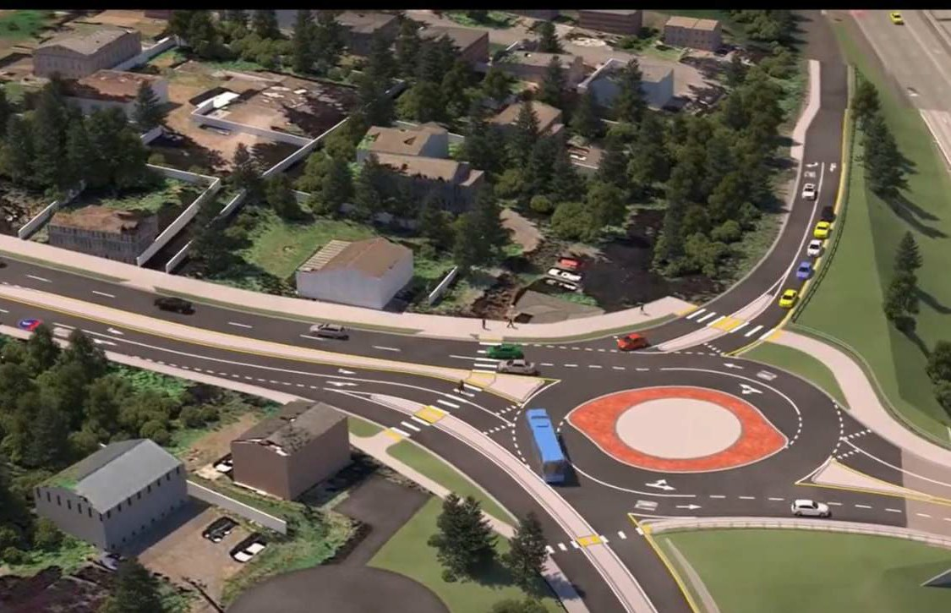
UPCOMING RIGHT-OF-WAY PROJECTS
Proposed non-motorized bridge at NE 148th St
https://www.shorelinewa.gov/government/projects-initiatives/148th-street-pedestrian-bicycle-bridge
Proposed roundabout at NE 145th St
https://www.shorelinewa.gov/our-city/145th-street-corridor/sr-523-n-ne-145th-street-i-5-interchange-project
Windermere Real Estate/GH LLC
210 5th Ave S Suite 102 | Edmonds, WA 98020
edmonds@windermere.com | 425.672.1118

Slide 8
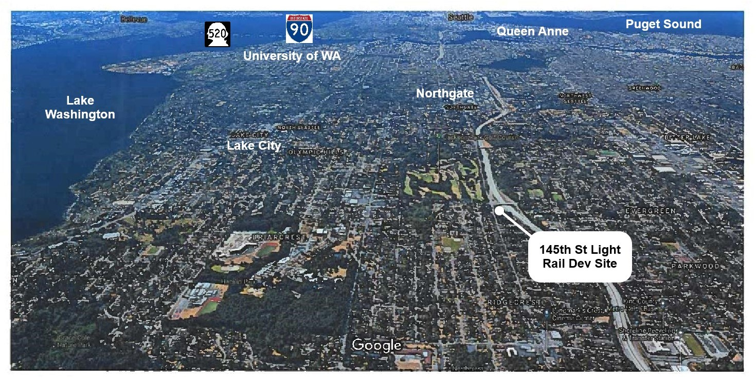
NEIGHBORHOOD MAP
Windermere Real Estate/GH LLC
210 5th Ave S Suite 102 | Edmonds, WA 98020
edmonds@windermere.com | 425.672.1118

Slide 9
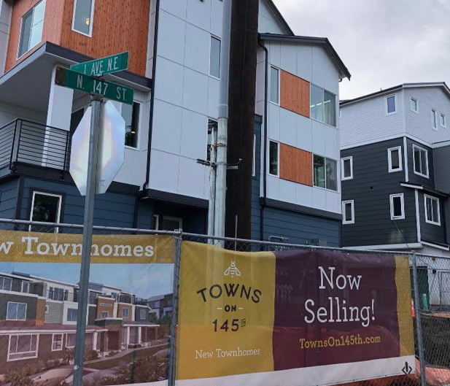
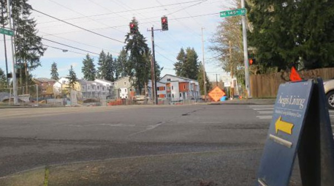
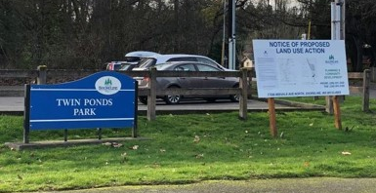
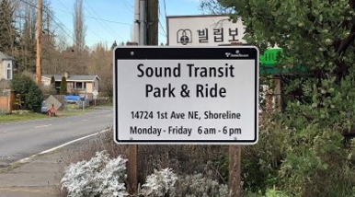
NEIGHBORHOOD MAP
At NE 145th St looking north, at 1st NE- the entry into the neighborhood
Park at NE 1st St and NE 155tth St
Townhomes along west of NE 1st St
Park and Ride at churches along east of NE 1st St
Windermere Real Estate/GH LLC
210 5th Ave S Suite 102 | Edmonds, WA 98020
edmonds@windermere.com | 425.672.1118

Slide 10
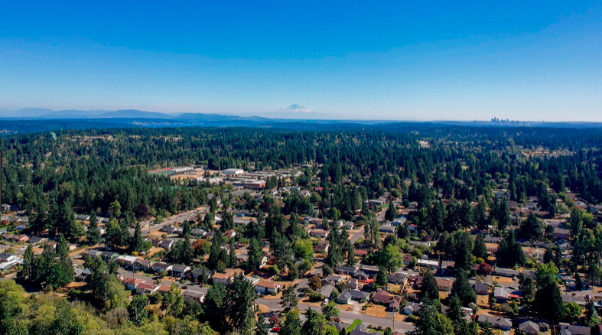
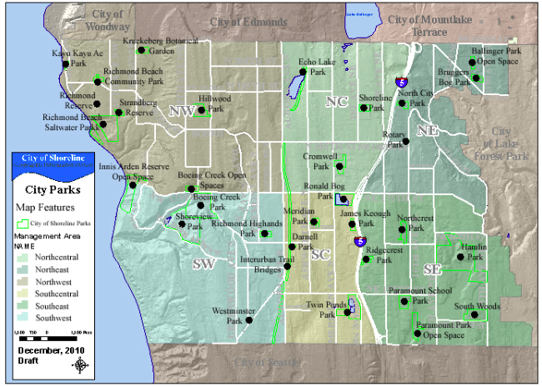
CITY OF SHORELINE
Shoreline boasts a unique history and character derived from original settlements dating back to the late 1800s. The quality that drew early settlers to the area remains dominant to this day: location. The City of Shoreline offers classic Puget Sound beauty and the convenience of suburban living with the attractions of nearby urban opportunities.
Before becoming a city in 1995, the City of Shoreline was an island of unincorporated King County surrounded by the older cities of Seattle, Edmonds, Woodway and Lake Forest Park. Covering 11.74 square miles, Shoreline has a population of more than 53,000 residents. It is primarily residential with more than 70 percent of the households being single-family residences. Over the years, the Shoreline community has developed a reputation for strong neighborhoods, excellent schools and abundant parks.
From breathtaking views of Puget Sound to tennis, indoor swimming to nature trails and beach access to skateboarding, Shoreline's more than 400 acres of park land and open space offer a variety of enriching recreation and outdoor experiences. The City recently invested $18.5 million to improve its parks, which include saltwater shoreline, a botanical garden, an interurban trail and hiking trails, and newly improved athletic fields, courts and playgrounds.
Shoreline residents enjoy stellar public and private schools that are consistently recognized for strong test scores and active community support. Shoreline is also home to Shoreline Community College, a nationally recognized local resource.
Windermere Real Estate/GH LLC
210 5th Ave S Suite 102 | Edmonds, WA 98020
edmonds@windermere.com | 425.672.1118

Slide 11
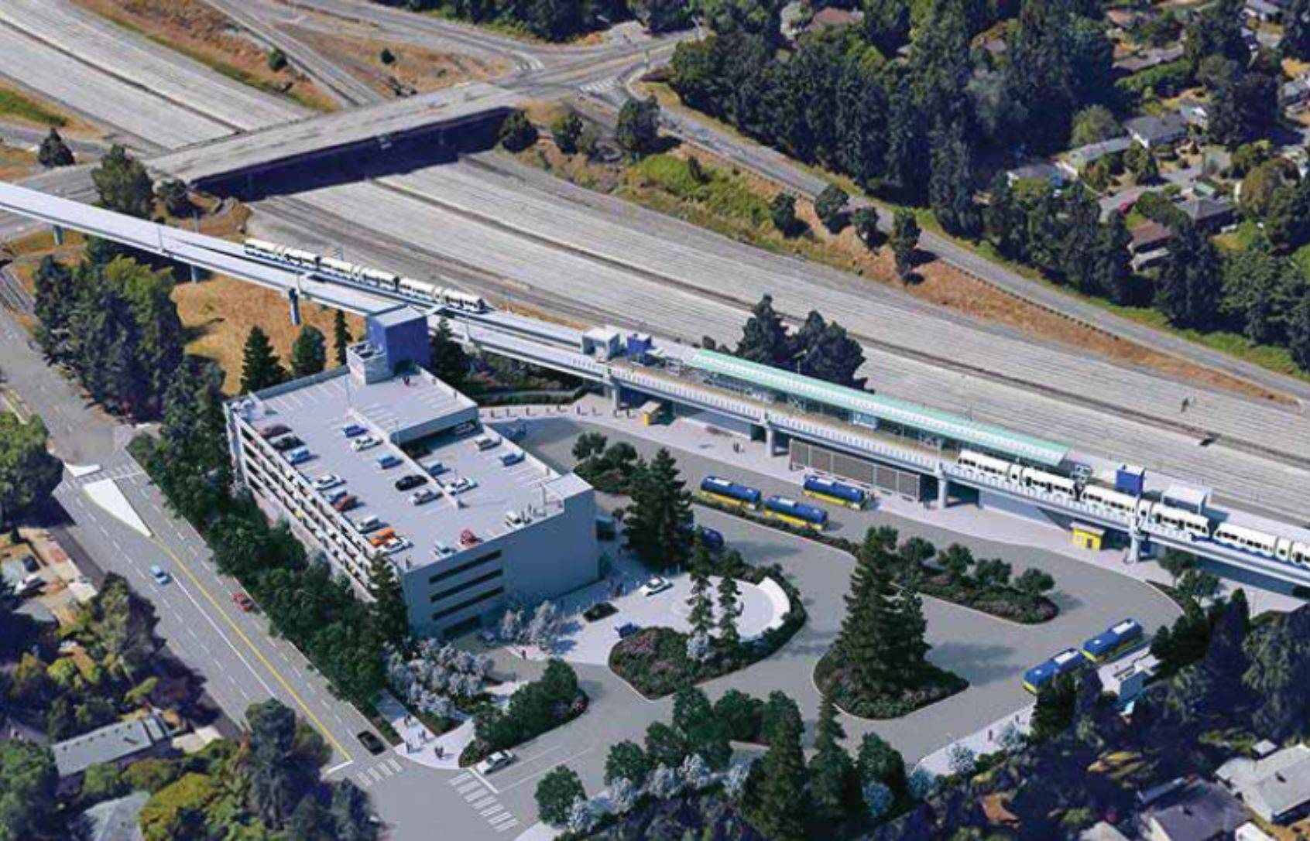
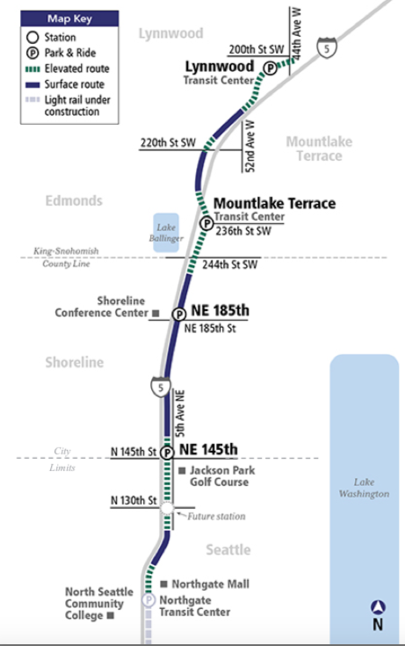
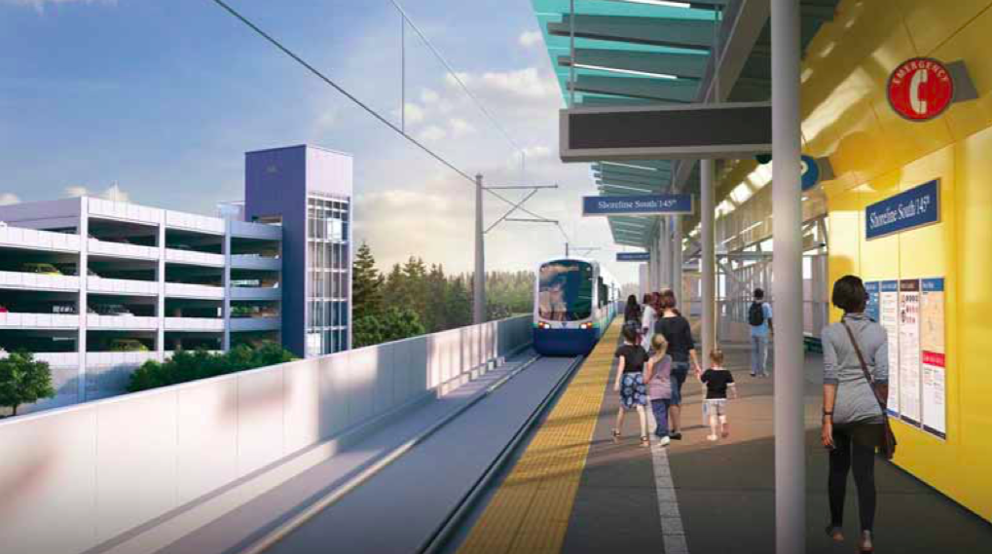
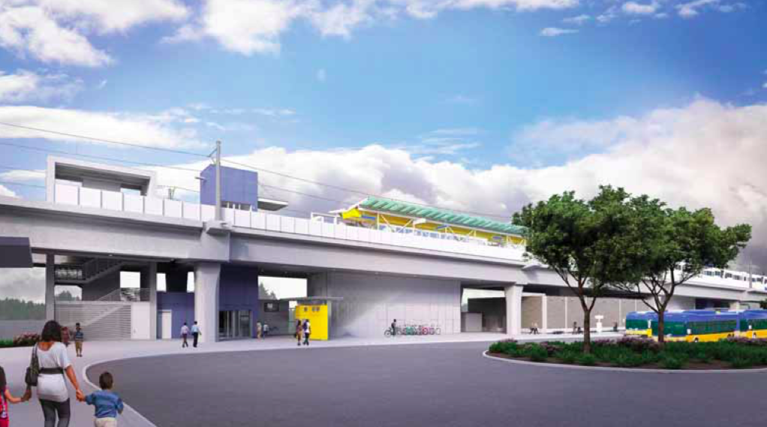
SOUND TRANSIT LINK LIGHT RAIL
ST2 will substantially expand the regional mass transit system by extending and adding more light rail lines and increasing commuter rail and regional express bus service. This new service will enhance and add high-capacity transit in the region’s main travel corridors. The result will be service that cuts through congestion and provides ridership capacity to accommodate the region’s needs.
ST2 expands light rail north from the University of Washington to Lynnwood, adding seven planned new stations in the University District, the Roosevelt neighborhood, Northgate, 145th Street/Jackson Park, Shoreline, Mountlake Terrace and Lynnwood. This extension is scheduled to be open to Northgate by 2020 and to Lynnwood by 2024.
Sound Transit anticipates the 145th project starting construction in 2019 and opening for service in 2024. Daily projections estimate between 63,000 and 74,000 riders each weekday by the year 2035. Trains are set to arrive every 4-5 minutes during peak hours and riders can expect a 16 minute commute from the 145th Station to downtown Seattle. These transit times will save around 14-16 minutes during peak morning commute hours.
Windermere Real Estate/GH LLC
210 5th Ave S Suite 102 | Edmonds, WA 98020
edmonds@windermere.com | 425.672.1118

Slide 12





BUILDING PLANS
s
s
s
s
c c c c c c c c
LOBBY
s
s
s
20'-0"
s
C C C C C C _{s}
s
s
s
s
23'-0"
20'-0"
c c c
s
s
s
s
s
C C C
s
20'-0"
s s
C
s
s
s
s
s
C
c c
RAMP UP
C C C
c
s
s
C
s
s
s
s
s
s
16'-0"
c
c c c c
C
C C C C C C s
s
c
OVERHEAD sEcURITY DOOR
C
c
C
23'-0"
s
s
s
c c c c c c c c c c c c
20'-0"
23'-1"
C C C C C C C C C C C C
s
s
16'-0"
s
RAMP DO
s
s
s
s
c c c c c
c
s
C C C C
C
s
s
s
c
s
C C
s s
s
s
s
s c c c
c
s s s
c c c c c
c c c
C C C C C
s
s
s
s C C C
C C C
s s s
s s s
s s s
s s
s
s s s
s s s
s s s
s s
s
s
s
s
s
s
s
20'-0"
23'-0"
20'-0"
s
s
s
s
c
s
s
s
c
s
C
s
c
s
C
s
c
s
C
s
C
s
s
s s
s
s
s s
c
s
s
c
s s
C C C
c
LEVEL P1
LEVEL P2
Windermere Real Estate/GH LLC
210 5th Ave S Suite 102 | Edmonds, WA 98020
edmonds@windermere.com | 425.672.1118

Slide 13

BUILDING PLANS
NE 147TH ST
37'-2"
37'-2"
OPEN TO
E OW
5'-3"
5'-3"
RAMP DOWN TO GARAGE
3RD AVE NE
25'-0"
25'-0"
OW
O RT ARD WA
-
NE O
D NG A OVE
25'-0"
16'-6"
5'-3"
25'-0"
5'-3"
24'-2"
21'-0"
25'-0"
25'-0"
5'-3"
24'-2"
21'-0"
42'-2"
42'-2"
74'-7"
74'-7"
25'-0"
25'-0"
5'-3"
5'-3"
25'-0"
15'- "
2''-0" 5'-3"
35'- "
25'-0"
15'- "
26'-0" 5'-3"
35'- "
10'-'"
10'-6"
LEVELS 2-7
LEVEL 1
NE 145TH ST
Windermere Real Estate/GH LLC
210 5th Ave S Suite 102 | Edmonds, WA 98020
edmonds@windermere.com | 425.672.1118

Slide 14
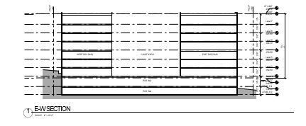
BUILDING PLANS
HT LIMIT 418.10'
ROOF 418.00'
Level 7
407.00'
Level 6
397.50'
11'-0" 9'-6" 9'-6" 9'-6" 9'-6" 9'-6" 9'-6" 11'-0"
NE 147TH ST
Level 5
388.00'
NE 145TH ST
70'-0"
INTERVENING LOT (NOT PART OF PROJECT)
Level 4
378.50'
Level 3
369.00'
Level 2
359.50'
Level 1
350.00'
AVG GRADE
RESIDENTIAL LOBBY
PAR ING
348.10'
PAR ING
LEVEL P-1 339.00'
LEVEL P-2
330.00'
Windermere Real Estate/GH LLC
210 5th Ave S Suite 102 | Edmonds, WA 98020
edmonds@windermere.com | 425.672.1118

Slide 15
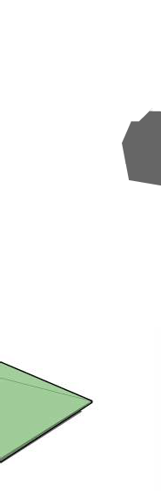
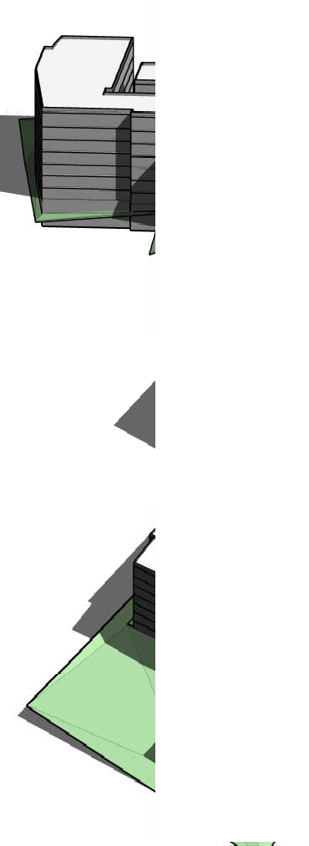
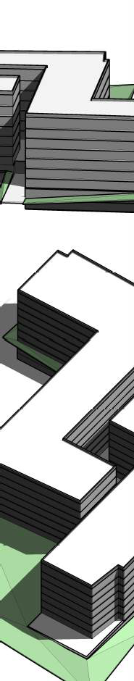
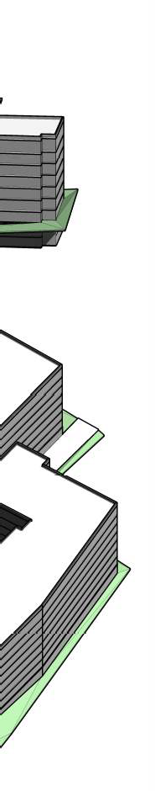
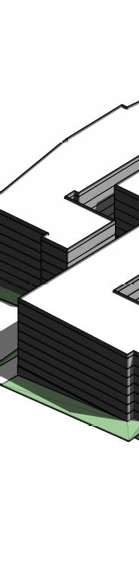
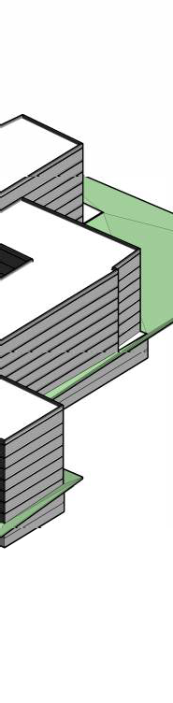
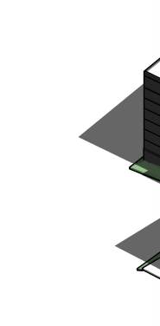
BUILDING MASSING
Interstate 5
NE 147th St
Massing view from west
NE 147th St
Interstate 5
Massing view from northwest
NE 145th St
Massing view from southeast
Windermere Real Estate/GH LLC
210 5th Ave S Suite 102 | Edmonds, WA 98020
edmonds@windermere.com | 425.672.1118

Slide 16
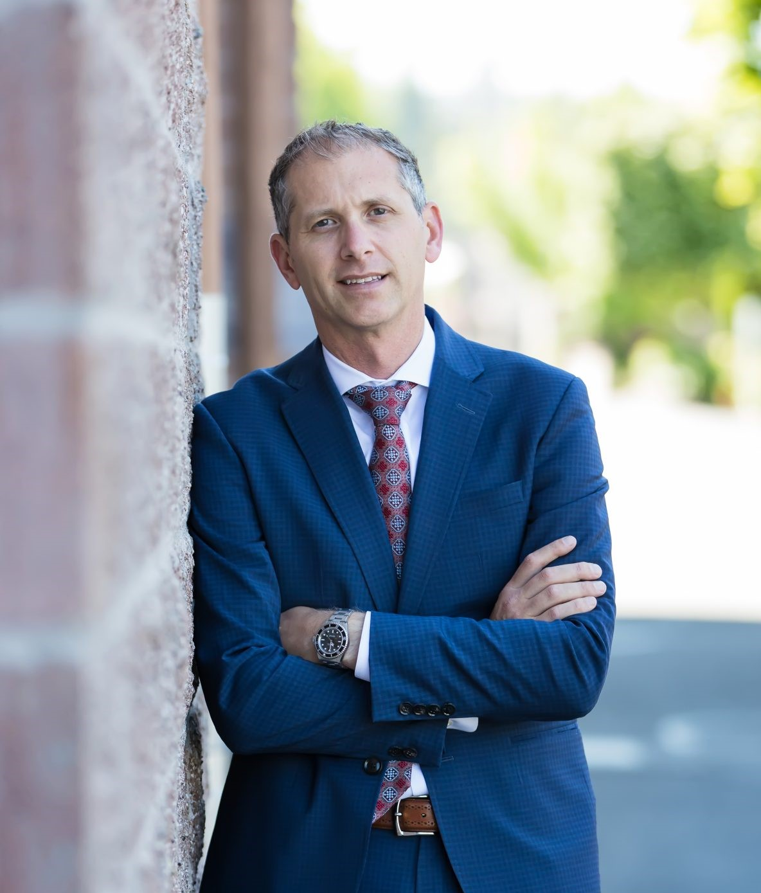

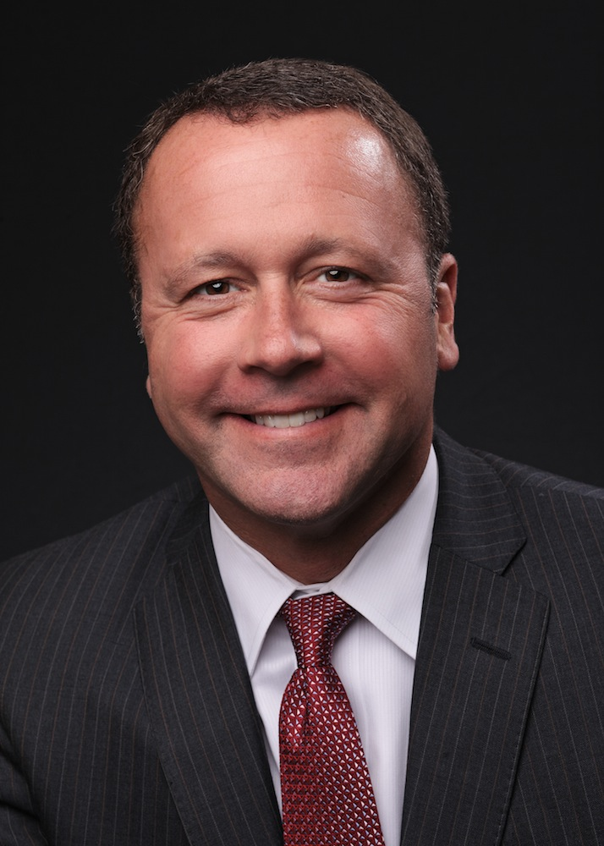
OUR TEAM
ADAM E.COBB
PREMIER DIRECTOR AT WINDERMERE REAL ESTATE, EDMONDS
Adam Cobb epitomizes integrity and hard work in every detail of your real estate transaction. Adam grew up in Edmonds and started his love for real estate at a young age. He has been able to use his knowledge of local market, love for the Pacific Northwest, and tireless dedication to ensure your transaction is seamless. With 10 years of experience and over $300 million in sales, he has worked every aspect of the industry representing sellers, buyers, investors, and builders, in both residential and commercial markets.
RYAN HOFF
MANAGING BROKER AT WINDERMERE REAL ESTATE, EDMONDS
Striving to be known for my loyalty, compassion, and communicative characteristics are my largest priorities. I always consider these qualities and pride myself in that if they are consistently portrayed, my clients will receive the most benefit from my work.
My family has been in the business for many years, giving me experience and knowledge in this industry for practically my entire life and most directly over the 7 years I have had my real estate license.
GREG HOFF
OWNER/DESIGNATED BROKER
AT WINDERMERE REAL ESTATE, EDMONDS
Greg is the Owner/Designated Broker of the Windermere Edmonds and Windermere Mukilteo offices. As the company's owner, his priority is to provide a productive and fun environment in which brokers can prosper. Greg is passionate about being available to support his brokers, giving his brokers the tools and support they need to meet their goals, and to serve their clients.
Additionally, Greg is passionate about giving back to the community.
Windermere Real Estate/GH LLC
210 5th Ave S Suite 102 | Edmonds, WA 98020
edmonds@windermere.com | 425.672.1118

Slide 17
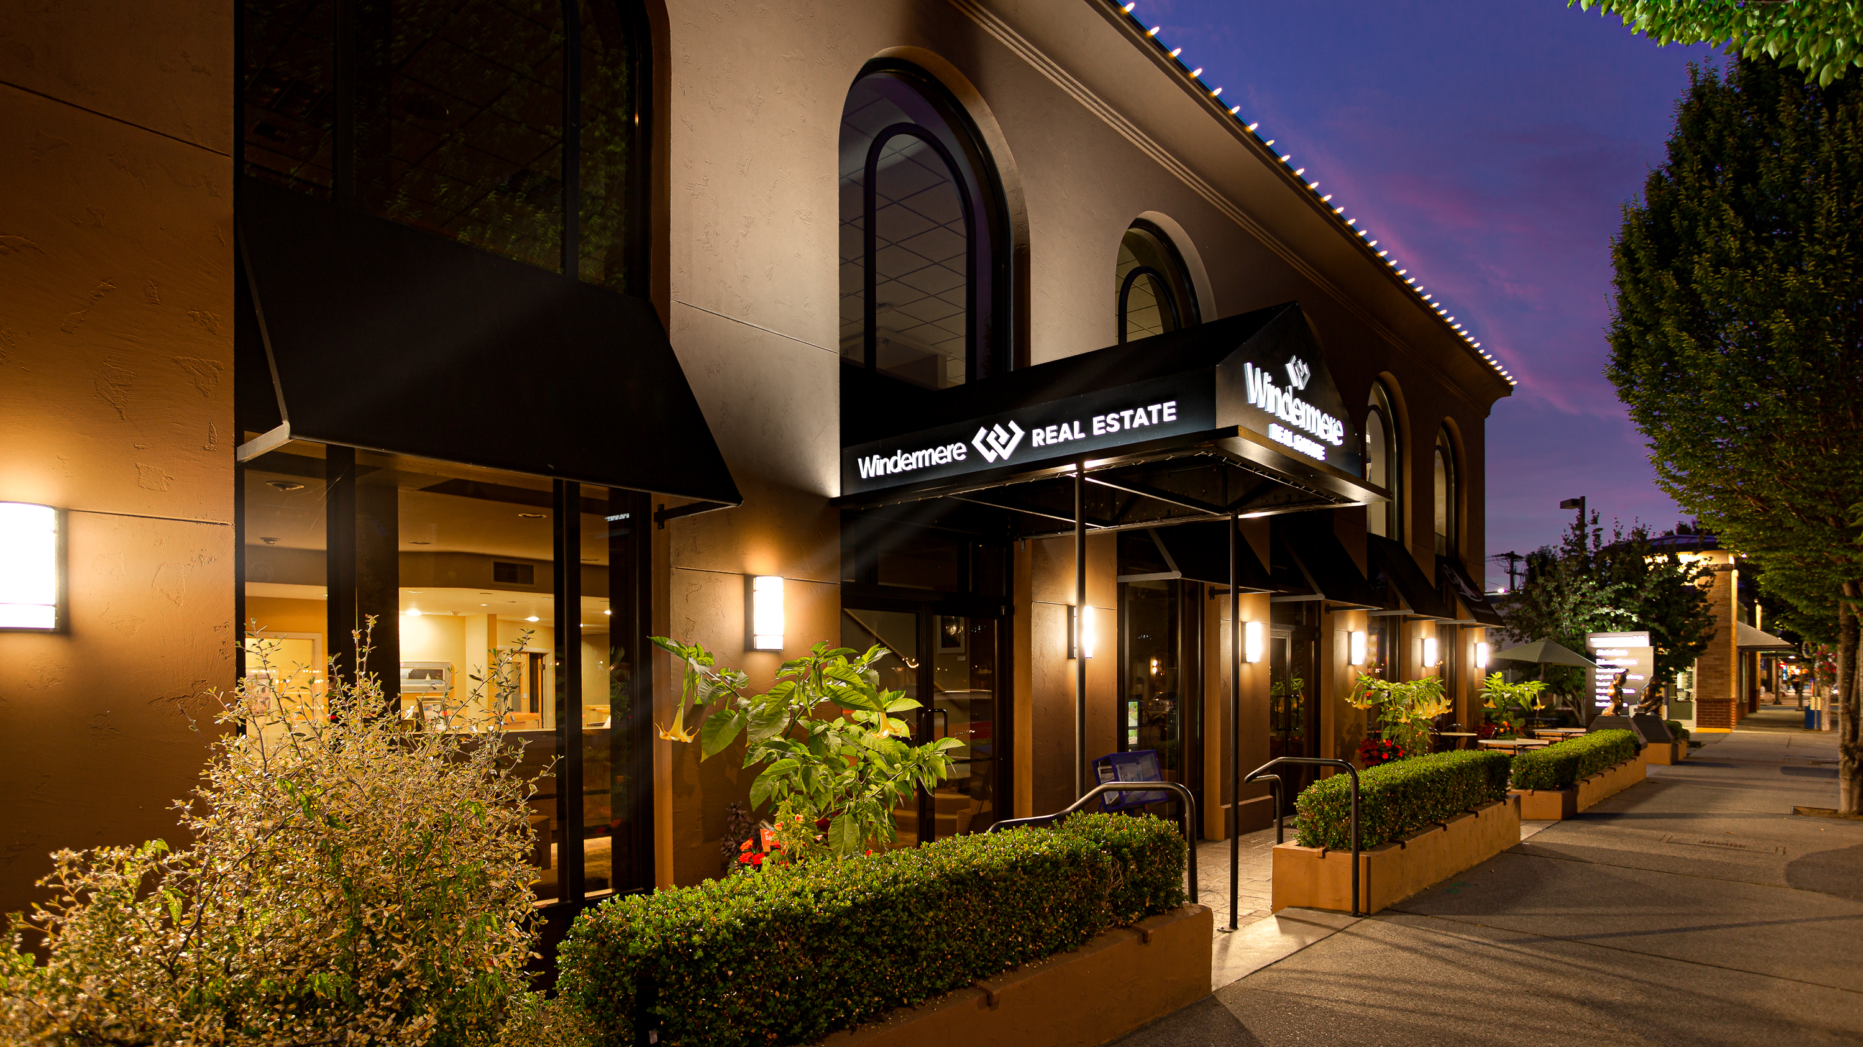
WINDERMERE EDMONDS
LIFE IS BETTER WHEN YOU
LOVE WHERE YOU LIVE

